Slide 1

CSCI 4502/5502
Data Mining - Fall 2023 - Lecture 14
Ravi Starzl, PhD

Slide 2
1
Basic Concepts
2
Partitioning Methods
Cluster Analysis
3
Hierarchical Methods
4
Density-based Methods
5
Grid-based Methods
6
Evaluation of Clustering
Ravi Starzl, PhD - Data Mining Fall 2023

Slide 3
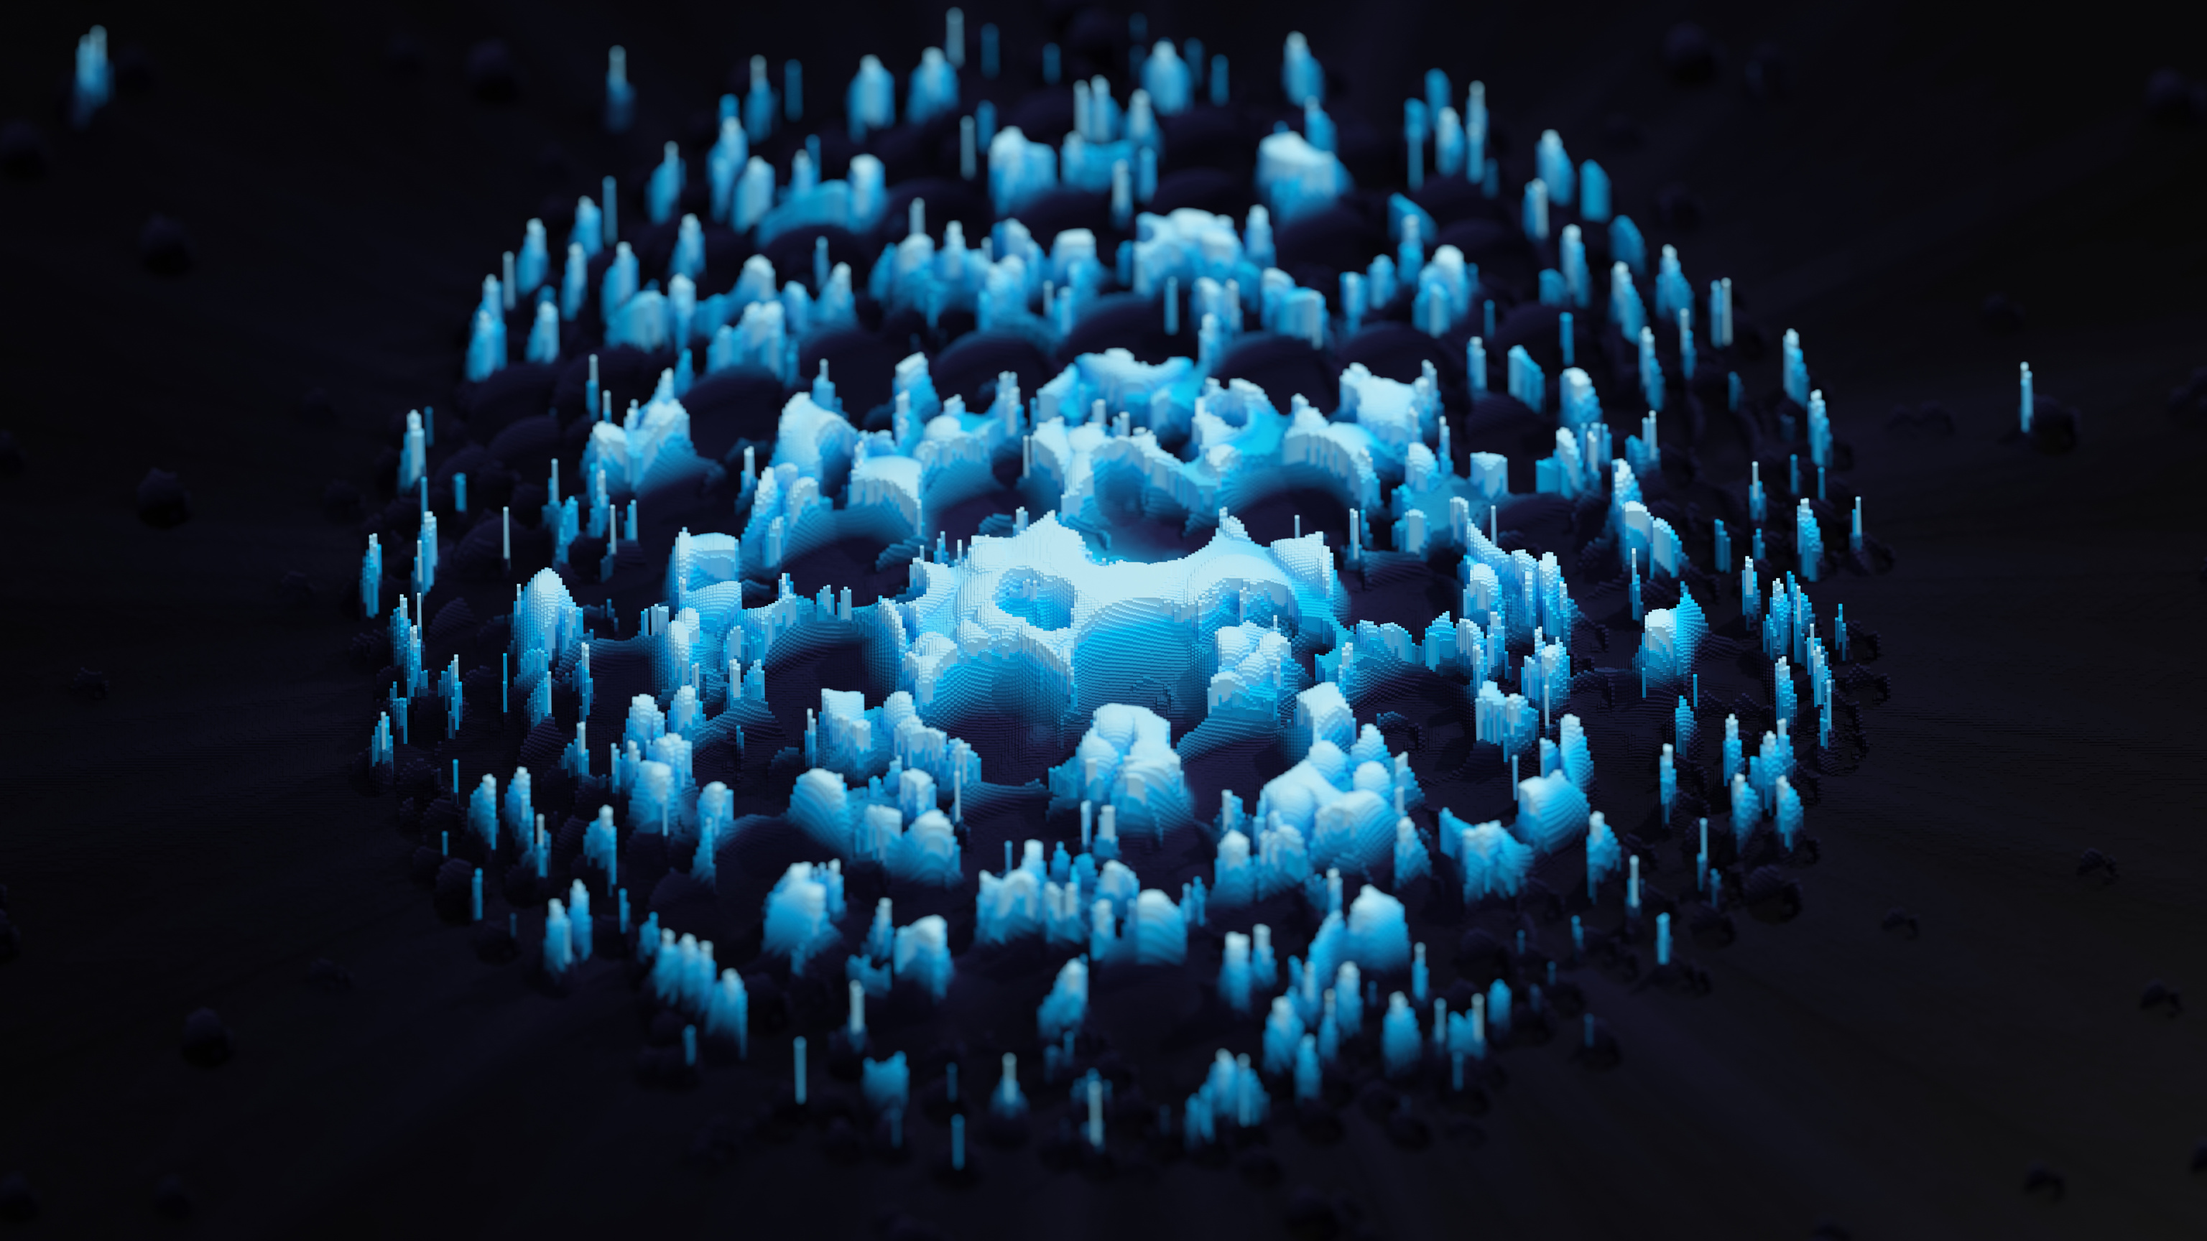
What is Cluster Analysis?
Cluster: a collection of data objects
similar to one another within a cluster
dissimilar to objects in other clusters
Cluster analysis
group similar data objects into clusters
similarity measure & clustering algorithm
Unsupervised learning
no predefined classes
Ravi Starzl, PhD - Data Mining Fall 2023
Notes:
Cluster Analysis in Computer Science and Data Mining offers a clear understanding of the concept and its significance, particularly in correlation with unsupervised learning. Analogies such as 'fruit' and 'tour guide' effectively explain the abstract concept of cluster analysis and unsupervised learning.
Similarities and Clustering Algorithms discusses 'similarity' and its role in forming clusters, with clustering algorithms quantifying this similarity. The five main types of clustering algorithms are mentioned but may benefit from brief definitions for completeness.
Unsupervised Learning and its Connection to Cluster Analysis explains unsupervised learning, its contrast with supervised learning, and its significance in cluster analysis, emphasizing the machine's ability to interpret and group data independently.
Summary of Cluster Analysis and Unsupervised Learning effectively summarizes the relationship between cluster analysis and unsupervised learning, the importance of clustering algorithms, and the use of similarity measures, but may benefit from a brief recap of the five types of clustering methods.
---
Cluster analysis groups similar objects, conceptualized through analogies such as grouping like 'fruits' together. This grouping is achieved through the measurement of similarity among objects and is fundamental in navigating through complex data.
Understanding cluster analysis involves recognizing its goal to group data objects based on likeness and interaction patterns. 'Similarity' characterizes shared attributes or properties between data objects, such as common characteristics among fruits like apples and oranges, providing a basis for their clustering.
Clustering algorithms quantify 'similarity' and group data objects into appropriate clusters. Different algorithms, such as partitioning methods, hierarchical methods, density-based methods, grid-based methods, and model-based methods, are designed to handle various data scenarios.
The connection between cluster analysis and unsupervised learning is pivotal. Unsupervised learning, which involves interpreting unclassified data and identifying patterns independently, provides the framework within which cluster analysis operates.

Slide 4
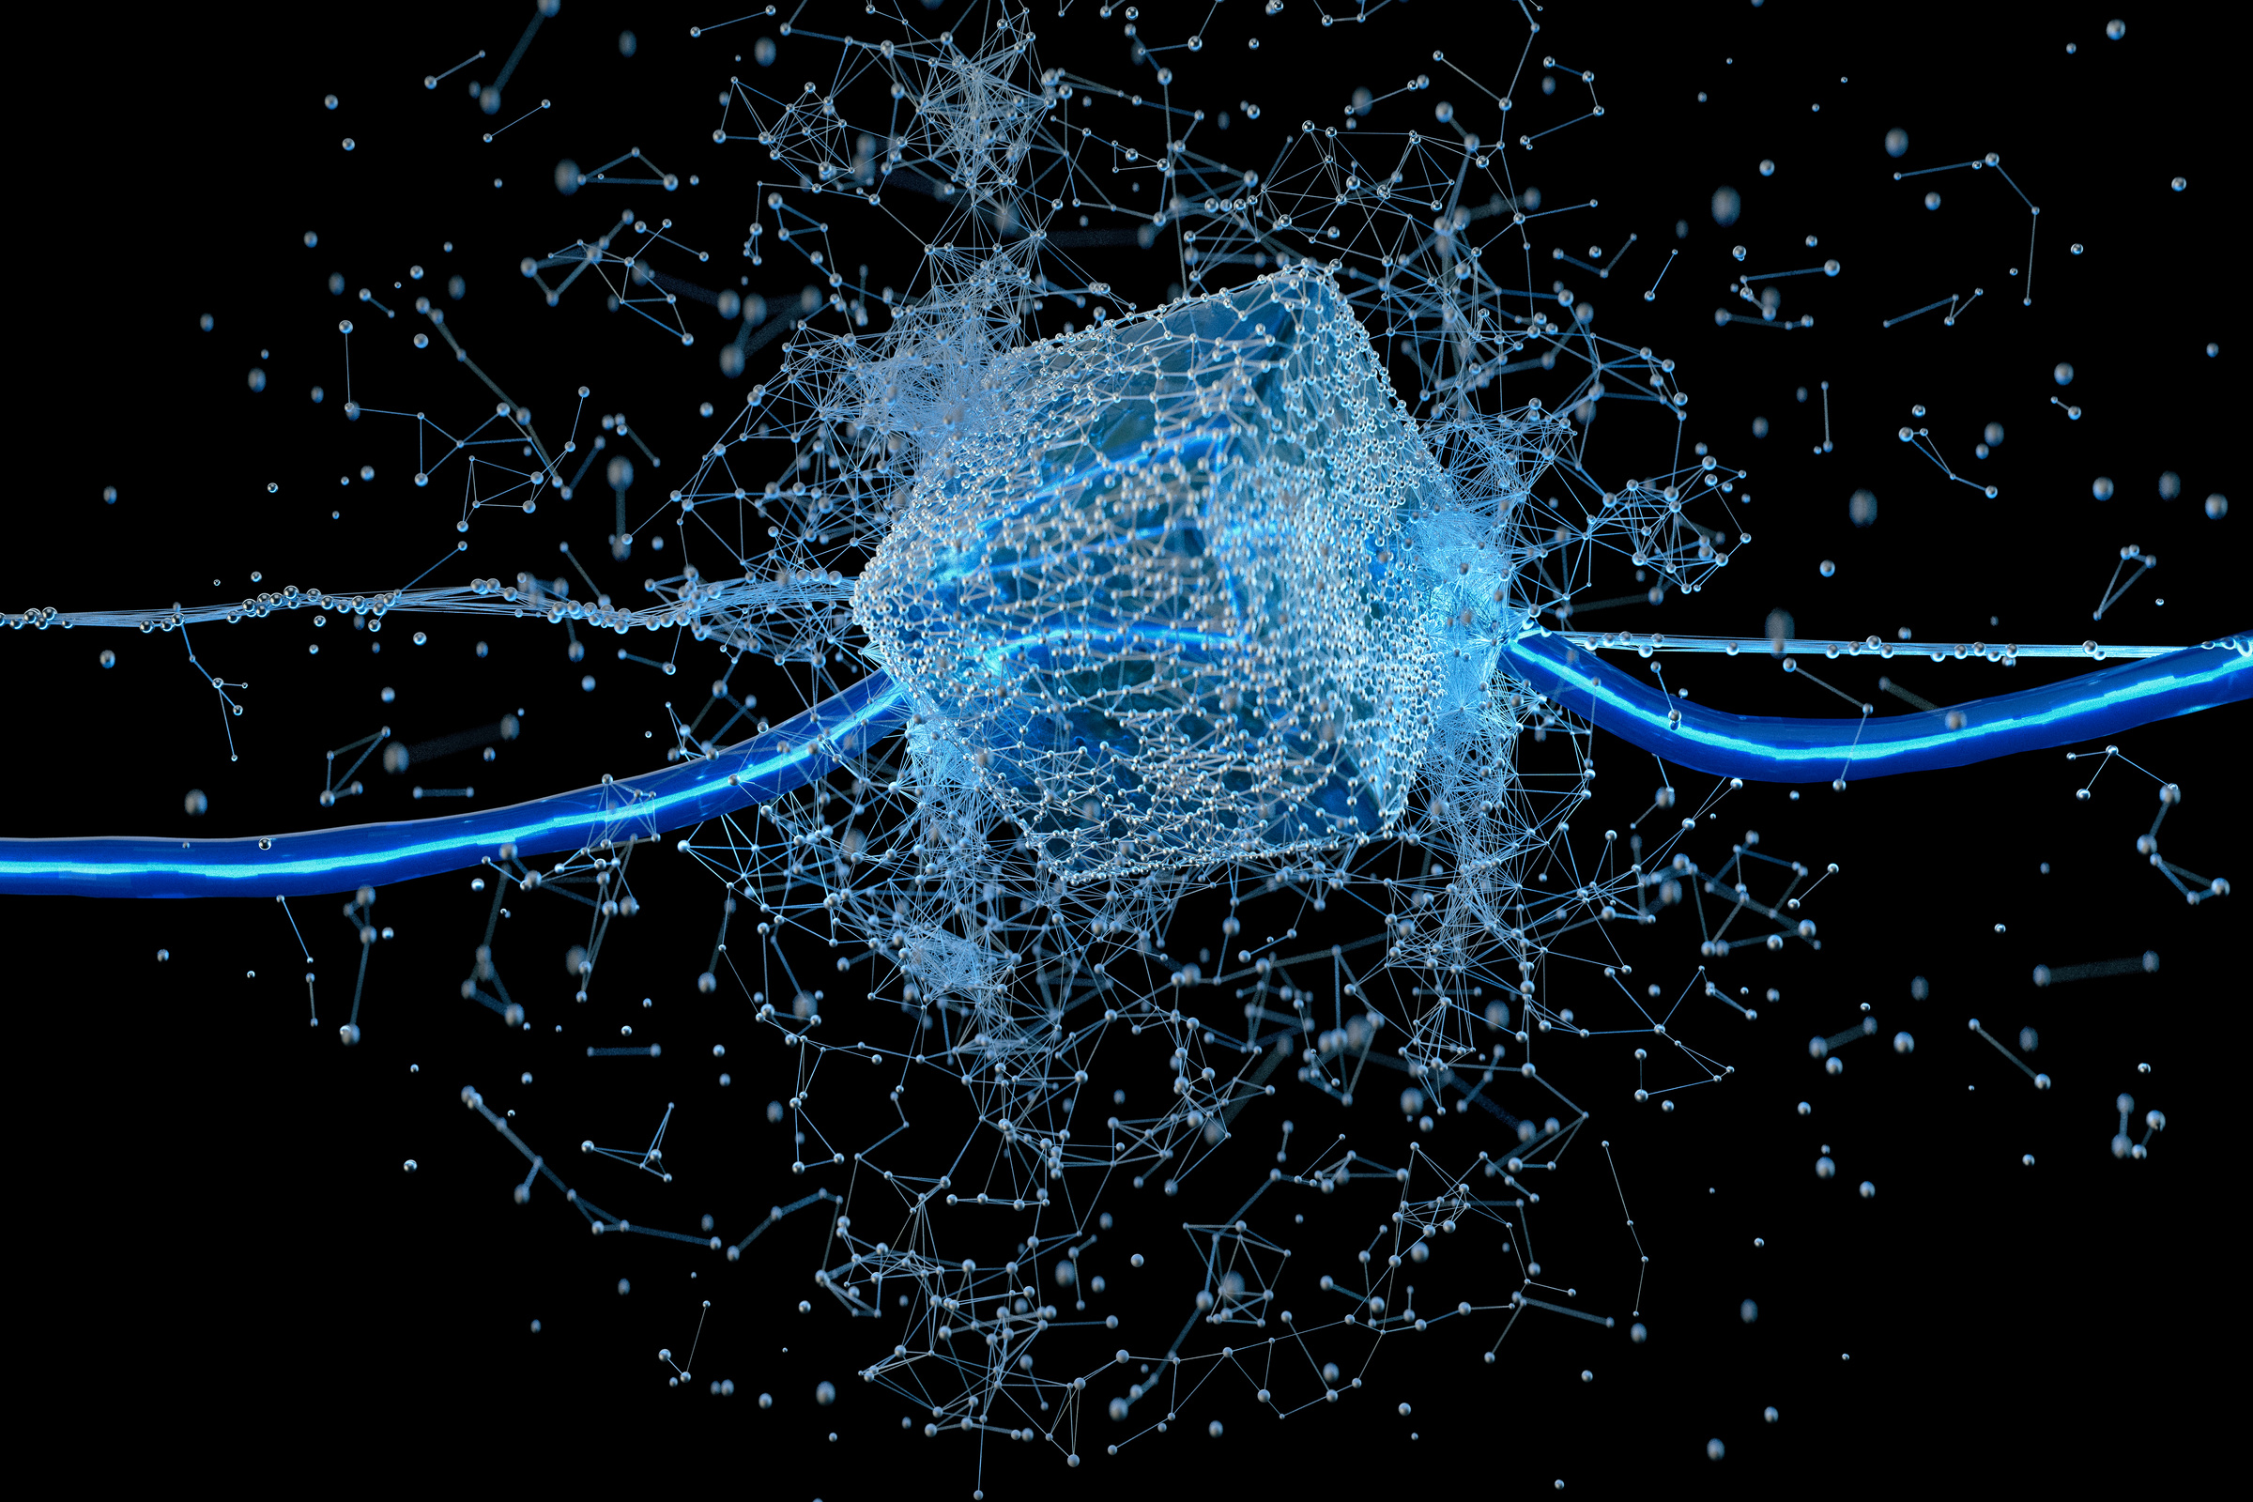
Requirements of Clustering
Scalability
Different types of attributes
Clusters with arbitrary shape
Minimal domain knowledge for parameters
Noisy data
Incremental, insensitive to input order
High dimensionality
Constraint-based clustering
Interpretability and usability
Ravi Starzl, PhD - Data Mining Fall 2023
Notes:
Scalability of Clustering explains the need for an efficient clustering algorithm to maintain performance despite increases in data size or amount.
Different Types of Attributes provides a comprehensive explanation about dealing with various attributes—numerical, categorical, binary, ordinal, etc.—emphasizing that effective clustering should accommodate the unique features of different data types.
Clusters with Arbitrary Shapes discusses the requirement of a clustering algorithm to identify and cluster data of varying shapes, not limiting its utility to spherical data structures only.
Minimal Domain Knowledge for Parameters highlights the desirability for algorithms to function independently with minimal reliance on domain-specific knowledge for parameters.
Noisy Data outlines that effective clustering includes handling noisy data, ensuring an algorithm can filter irrelevant data while maintaining cluster integrity.
Incremental Processing/Insensitivity to Input Order emphasizes the need for consistency in output regardless of the order of input data, discussing the stability and reliability of algorithms.
High Dimensionality addresses the problem of high dimensionality, focusing on the need for clustering algorithms to implement strategies like dimensionality reduction to tackle the 'curse of dimensionality'.
Constraint-Based Clustering stresses the effective management of inherent constraints derived from prior domain knowledge to improve robustness and accuracy in clustering.
Interpretability and Usability emphasize the importance of a user-friendly interface, easy learning curve, and interpretability.
---
Scalability in clustering ensures that algorithms maintain performance and provide results even as data size increases. A scalable algorithm should accommodate various data sizes, shapes, and complexities without a loss of performance.
Addressing different types of attributes, such as numerical, categorical, binary, and ordinal, is pivotal. Each attribute type brings unique characteristics to data clusters, and an algorithm must be able to handle this diversity, creating meaningful clusters irrespective of the initial data type.
Recognizing clusters with arbitrary shapes is vital. Clusters may form in complex geometric configurations, not always spherical or linear. An algorithm must identify these varying forms, ensuring no bias towards specific shapes.
An algorithm should function with minimal reliance on domain-specific knowledge for parameters, enhancing its adaptability and accessibility. Independence from external domain knowledge broadens the algorithm’s applicability.
Handling noisy data involves filtering irrelevant data and maintaining the integrity of clusters. The algorithm must manage erroneous data points, irrelevant features, and discrepancies to preserve the credibility of clustering results.
Consistency in output, irrespective of the order of input data, is essential. An algorithm must provide consistent results regardless of the order in which the dataset is presented.
Dealing with high dimensionality involves employing strategies like dimensionality reduction to manage the complications of understanding and visualizing data. The algorithm must effectively combat the challenges presented by the "curse of dimensionality".
Constraint-based clustering involves navigating inherent constraints from pre-acquired domain knowledge, ensuring accurate and robust classifications. The algorithm must manage these constraints effectively to deliver precise results.
Emphasizing interpretability and usability, the algorithm’s output should be digestible and comprehensive, translating complex data into understandable formats. The algorithm should also be user-friendly, ensuring a manageable learning curve for users with varied expertise.
Each characteristic—scalability, managing diverse attributes, identifying arbitrary shapes, independence from domain knowledge, handling noise, insensitivity to input order, managing high dimensionality, respecting constraints, and ensuring interpretability and usability—is crucial for successful clustering. Understanding these characteristics provides a foundation for deciphering, designing, and delivering successful clustering tasks in subsequent discussions.

Slide 5
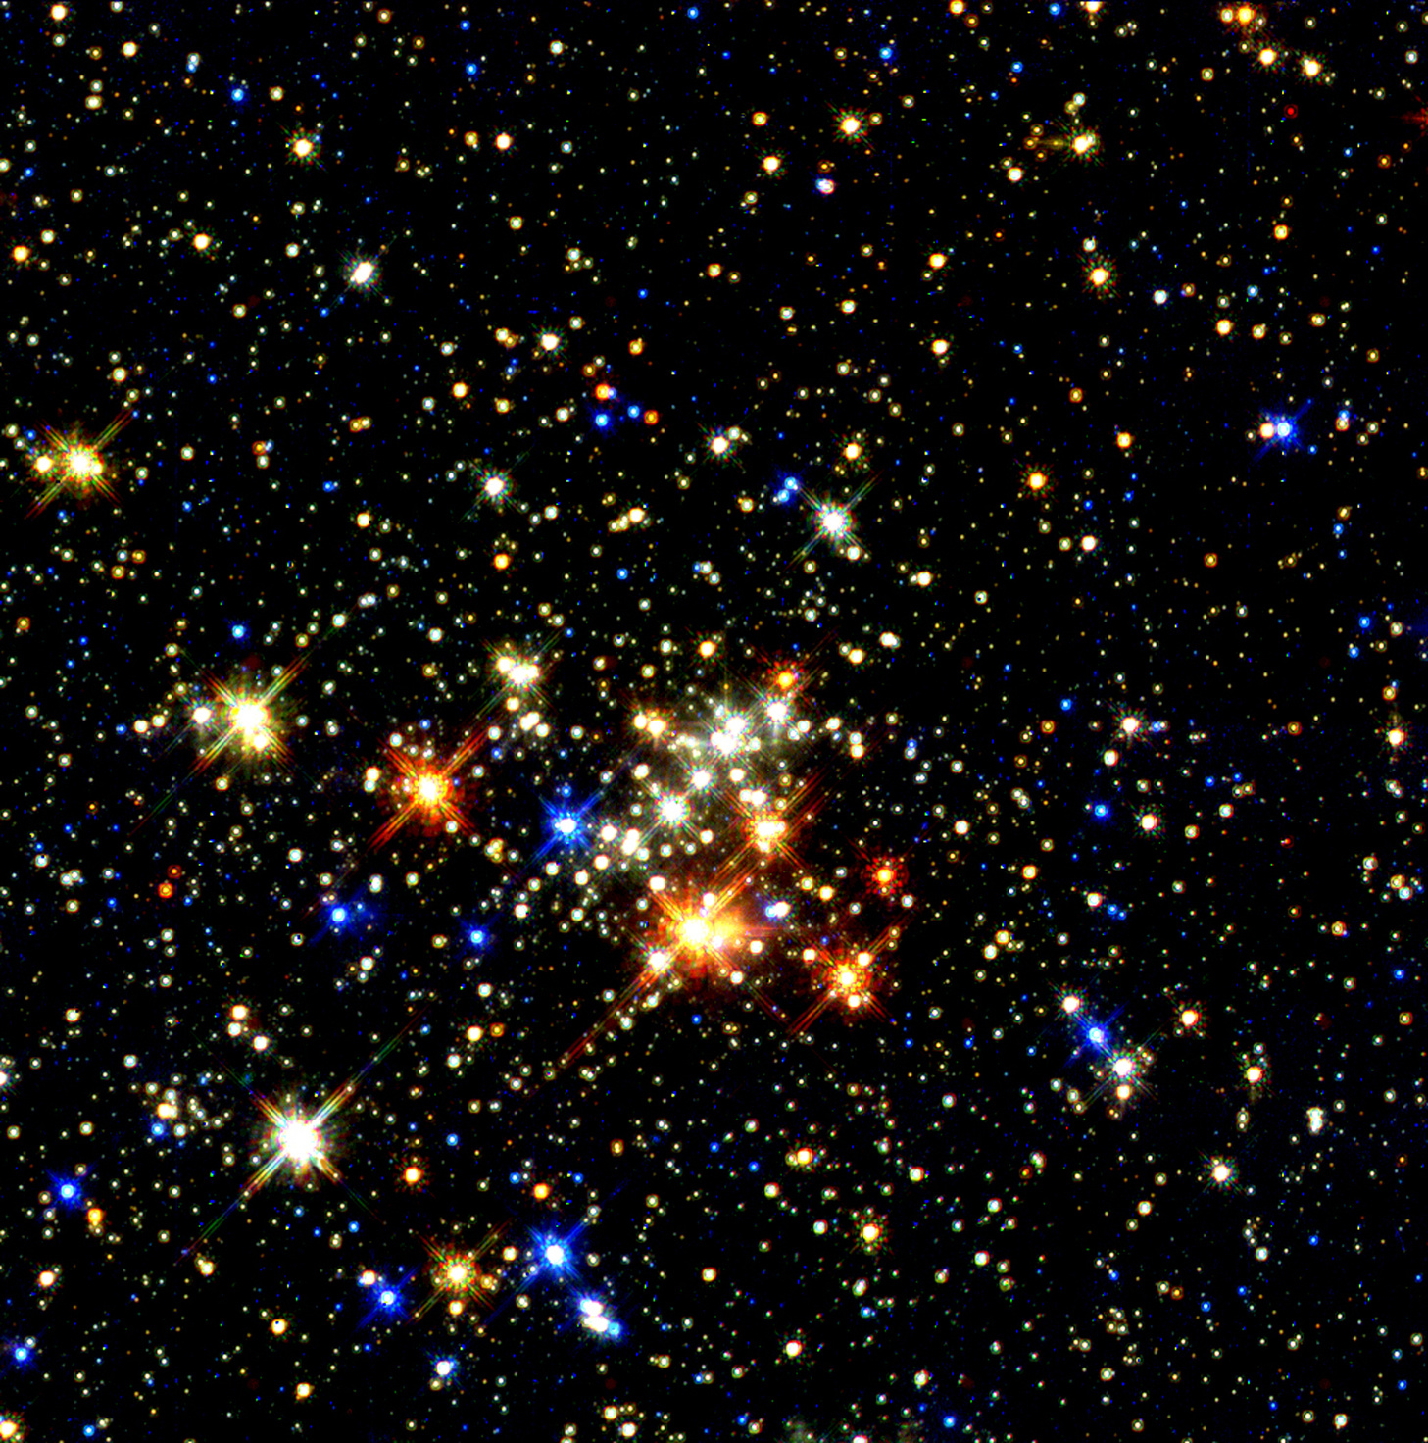
Major Clustering Methods (1)
Partitioning methods
construct k partitions, iterative relocation
Hierarchical methods
hierarchical decomposition, split/merge
Density-based methods
connectivity and density functions
Grid-based methods
quantize into cells, multigranularity grid
Ravi Starzl, PhD - Data Mining Fall 2023
Notes:
Partitioning Methods in Clustering details the k-means and k-medoids algorithms, distinguishing between them. The material lacks algorithmic steps or practical examples.
Hierarchical Methods in Clustering describes hierarchical methods, categorizing them into agglomerative and divisive types. The inclusion of diagrams, such as dendrograms, would enhance comprehension.
Density-Based Methods in Clustering provides an overview of density-based clustering, mentioning terms like density reachability and connectivity. It refers to the DBSCAN and OPTICS algorithms but doesn't elaborate on their operations or practical applications.
Grid-Based Methods in Clustering introduces grid-based methods, emphasizing their operation via a multilevel granularity data structure and mentioning STING as a key algorithm. A more detailed explanation of the grid structure and examples would enhance clarity.
Summary of Clustering Methods provides an overarching review of clustering methods, discussing their advantages and limitations and their significance in data analysis. A deeper exploration of criteria for method selection would be beneficial.
---
Partitioning methods in clustering involve dividing a database, with \( n \) objects, into \( k \) partitions. The k-means algorithm uses the mean value of objects in a cluster, whereas the k-medoids uses the median. K-means can be influenced by outliers, while k-medoids, due to its use of median, is more robust against such anomalies.
Hierarchical methods produce a tree of clusters. Agglomerative clustering starts with individual objects as clusters and merges them based on criteria until a single cluster remains. Divisive clustering, in contrast, starts with one large cluster, breaking it down until individual objects become their own clusters.
Density-based methods define clusters based on density and connectivity criteria. A cluster is formed if nearby points within a set distance exceed a minimum threshold. Clustering begins with a random point, expanding the cluster based on the set criteria. DBSCAN and OPTICS are examples of this approach.
Grid-based methods partition the data space into cells, creating a grid. Clustering is performed on this grid, and its complexity is tied to the number of grid cells, not data points. The STING algorithm exemplifies grid-based methods.

Slide 6
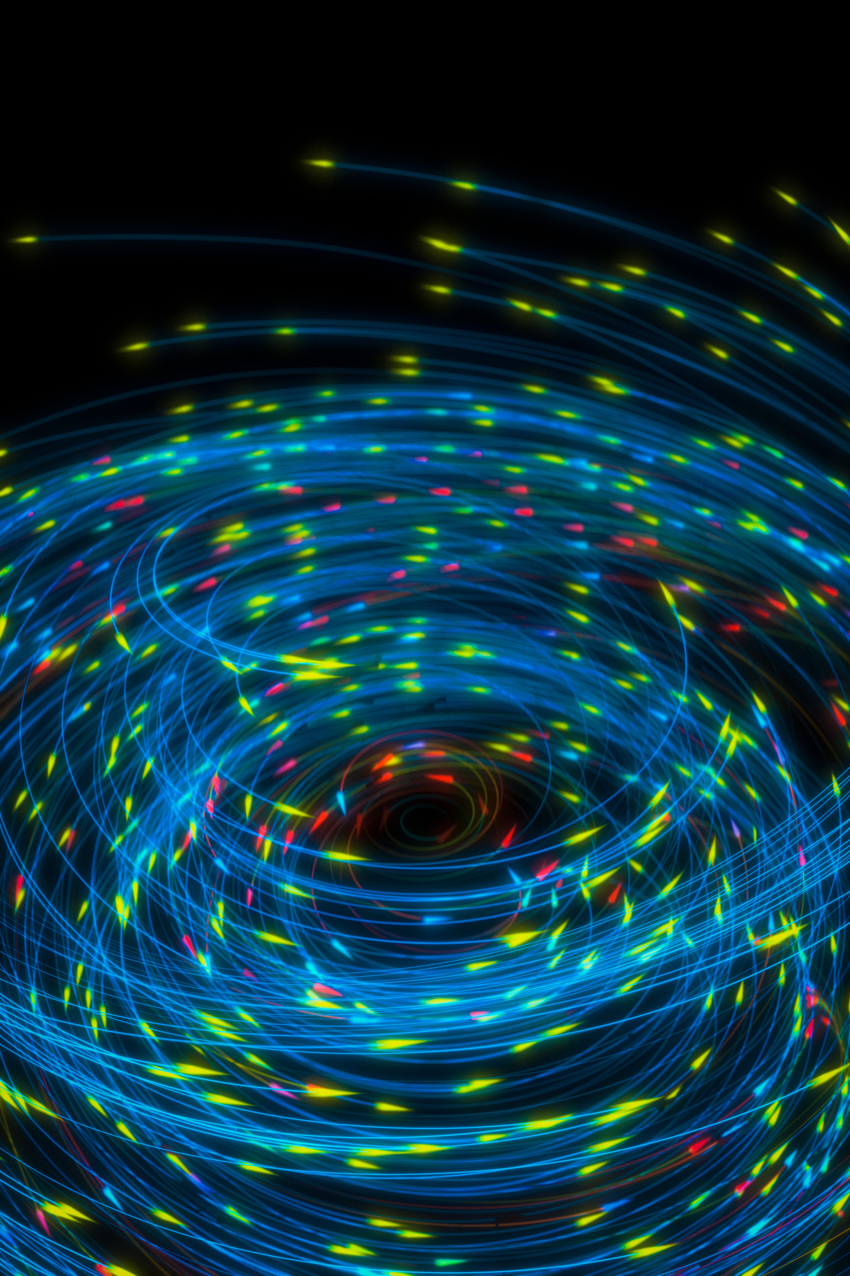
Major Clustering Methods (2)
Model-based methods
hypothesized cluster model, best fit
Clustering high-dimensional data
subspace clustering
frequent-pattern-based clustering
Constraint-based clustering
user-specified or application-oriented constraints
Ravi Starzl, PhD - Data Mining Fall 2023
Notes:
Model-Based Methods operate under the assumption that the data originates from a specific model, aiming to identify this originating model. These methods assume the data is a mixture of different distributions, each representing a cluster. Gaussian Mixture Models (GMMs) and Bayesian Clustering are key examples. GMMs view each cluster as a distinct Gaussian distribution, and each data point is associated with probabilities of belonging to these distributions. The model iteratively optimizes the distribution parameters to best fit the data, often using the Expectation-Maximization algorithm. These methods are advantageous in handling clusters of varied shapes and accounting for the uncertainty of point-cluster associations.
Clustering High-Dimensional Data involves handling data across numerous attributes, presenting a challenge due to the curse of dimensionality. This phenomenon results in data becoming sparse and the relative distances between points becoming indistinguishable as dimensionality increases. Strategies to manage high-dimensional data include Feature Selection, Feature Extraction, and Dimensionality Reduction, with specific methods like Subspace Clustering and Frequent-Pattern-Based Clustering offering targeted approaches. Subspace Clustering identifies clusters in subspaces of the data, while Frequent-Pattern-Based Clustering forms clusters around recurring patterns within the data, both of which navigate through the challenges of high-dimensionality in distinct ways.
Constraint-Based Clustering introduces user-defined or application-specific constraints into the clustering process, enhancing the ability of algorithms to meet specific application requirements. This method incorporates constraints like "must-link" and "cannot-link", which respectively dictate that certain points must or must not be co-clustered, ensuring that the clustering aligns more closely with user needs and application demands.

Slide 7
1
Basic Concepts
2
Partitioning Methods
Cluster Analysis
3
Hierarchical Methods
4
Density-based Methods
5
Grid-based Methods
6
Evaluation of Clustering
Ravi Starzl, PhD - Data Mining Fall 2023

Slide 8

Partitioning Methods
Given a data set D of n objects
Given k, find a partition of k clusters that optimizes the chosen partition criterion
Global optimal: enumerate all partitions
Heuristic methods
k-means: cluster represented by mean (centroid)
k-medoids: cluster represented by medoid (object closest to centroid)
Ravi Starzl, PhD - Data Mining Fall 2023
Notes:
Partitioning methods in data analysis aim to divide a dataset into clusters or subsets. The goal is to ensure high similarity within clusters and distinct differences between them.
The K-means method divides a dataset into predetermined clusters. It starts by selecting initial cluster centers and assigns data points to the nearest center. After assignment, cluster centers are recalculated and data points are reassigned. This continues until cluster centers remain unchanged.
The K-medoids method also divides a dataset into predetermined clusters but uses actual data points as cluster representatives. This approach is less sensitive to outliers compared to K-means, as outliers don't significantly alter the representative data point.
While achieving the best possible clustering solution is ideal, it's often computationally intensive. Heuristic methods offer a compromise, providing reasonably accurate results with less computational effort.
For instance, in retail, partitioning methods can segment customers based on similarities. This aids in crafting targeted marketing campaigns, optimizing resources, and enhancing customer engagement. Both K-means and K-medoids can be used, with the choice depending on the data characteristics and analysis goals.
In summary, partitioning methods, including K-means and K-medoids, offer effective techniques for data segmentation, aiding targeted data analysis and strategy formulation across various sectors. Selecting the appropriate method depends on the dataset and the analysis objectives.

Slide 9
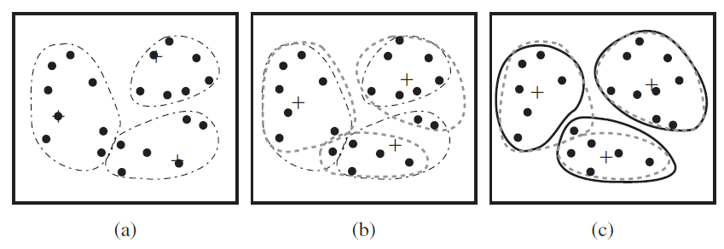
k-Means Clustering (1)
Partition objects into k nonempty clusters
Compute mean (centroid) of each cluster
Assign each object to closest centroid
Repeat till no more assignment changes
Ravi Starzl, PhD - Data Mining Fall 2023
Notes:
The k-means clustering algorithm categorizes a dataset into 'k' clusters, ensuring that data points in the same cluster are similar to each other. The parameter 'k' indicates the number of clusters and is specified by the user. This algorithm operates iteratively, beginning with the random selection of 'k' data points as initial centroids. Subsequent steps involve calculating distances between data points and centroids, assigning data points to the nearest centroid, and recalculating centroids. The iterations continue until data point assignments do not change between consecutive iterations.
Centroids in the k-means algorithm are not actual data points but are computed as the mean of all data points in a cluster. The Euclidean distance is commonly used to compute distances between data points and centroids. The algorithm is sensitive to the initial selection of centroids, and running the algorithm multiple times with different initial centroids may yield different results. One strategy to manage this sensitivity involves running the algorithm multiple times with different initial centroids and choosing the result with the least within-cluster variance.
Determining the appropriate value for 'k' is critical, and the elbow method is often employed for this purpose. It involves running the k-means algorithm for a range of 'k' values and plotting the within-cluster sum of squares (WCSS) for each value of 'k'. The optimal 'k' is usually where adding another cluster does not significantly reduce WCSS.
The k-means algorithm has limitations, including sensitivity to initial centroids and difficulty handling clusters of different shapes or sizes. It also assumes that clusters are spherical and that all clusters have similar variance, which may not be appropriate for all datasets. While the algorithm is widely used for its simplicity and efficiency, careful consideration of its limitations is required to ensure its appropriateness for the task at hand.

Slide 10
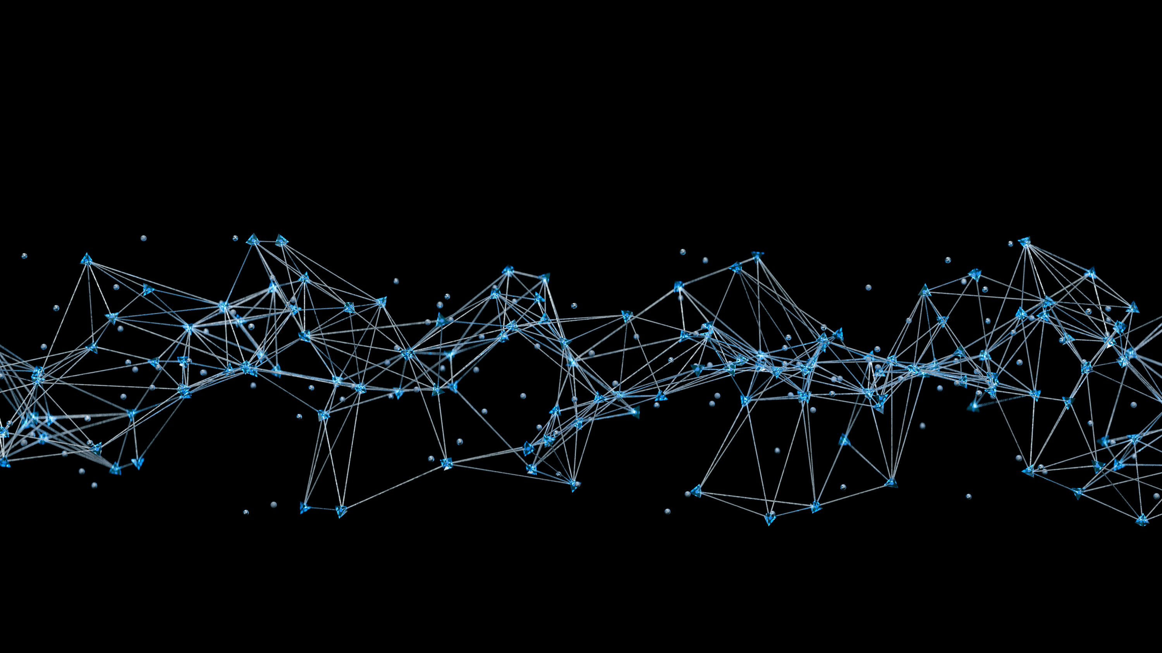
k-Means Clustering (2)
Relatively efficient: O(nkt)
n: #objects, k: #clusters, t: #iterations
Often terminates at local optimal
Applicable only when centroid is defined
Need to specify k in advance
Not suitable for discovering clusters with non-convex shapes
Sensitive to noise and outliers
Ravi Starzl, PhD - Data Mining Fall 2023
Notes:
k-Means Clustering is an unsupervised machine learning algorithm that partitions an unlabeled dataset into k different clusters. Each data point is assigned to the cluster with the closest mean, which serves as the prototype of the cluster.
Efficiency of k-Means Algorithm
The k-Means algorithm is recognized for its efficiency and high-performance characteristics. It operates with a time complexity of O(nkt), where 'n' represents the number of data points, 'k' represents the desired number of clusters, and 't' represents the number of iterations. The algorithm aims to minimize the sum of distances between each data point and the centroid of its assigned cluster and is especially suitable for large datasets with numerous variables.
Limitation: Local Optimum Solution
A notable limitation of the k-Means algorithm is its propensity to find a local optimum solution instead of a global one. To mitigate this, the algorithm may be run multiple times with different initial partitions to increase the likelihood of discovering a global optimum.
Limitation: Centroids Definition
Defining cluster centroids is a crucial step in implementing the k-Means algorithm. A centroid is computed as the arithmetic mean of all points within a cluster, across all dimensions. Categorical data can pose challenges in defining centroids, necessitating pre-processing steps, such as one-hot encoding, to convert the categorical variables into a format that is compatible with the k-Means algorithm.
Limitation: Predefined Number of Clusters
The k-Means algorithm requires the number of clusters, 'k', to be specified in advance. When the true 'k' is unknown, heuristic methods such as the Elbow or Silhouette method can be employed to estimate it, albeit with the risk of impairing the quality of clustering results and potential misinterpretation of data.
Limitation: Non-convex Shape Clusters
The k-Means algorithm assumes clusters to be spherical and may struggle to accurately identify clusters of non-convex shapes. This limitation makes it less effective for data comprising clusters of complex or irregular geometries.
Sensitivity to Noise and Outliers
The k-Means algorithm is sensitive to noise and outliers, as these extreme values can influence the assignment of data points to clusters and affect centroid calculations, leading to suboptimal results.

Slide 11
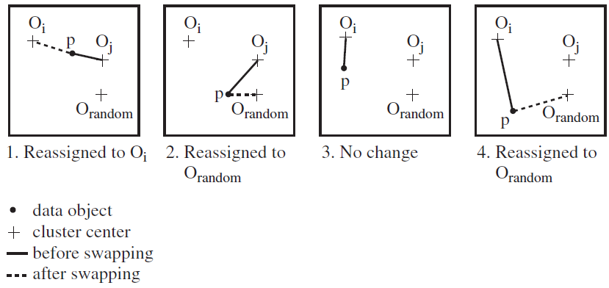
k-Medoids Clustering (1)
k-means method is sensitive to outliers
substantially distort the distribution of data
k-medoids: find representative objects (medoids)
Ravi Starzl, PhD - Data Mining Fall 2023
Notes:
K-Means and K-Medoids Clustering algorithms serve to partition an unlabeled dataset into a specified number of groups, or 'clusters.' While K-Means is effective, it is notably sensitive to outliers, which can significantly affect the calculated centroid and, consequently, the overall result. K-Medoids emerged as a variant to address this issue by using actual data points, or 'medoids,' from the dataset to represent clusters. Unlike K-Means, which uses calculated means, K-Medoids is less susceptible to outliers due to the nature of medoids.
K-Medoids Algorithm and its Outcomes
The K-Medoids algorithm begins by identifying 'k' medoids, where 'k' represents the desired number of clusters. Medoids are actual data points selected from the dataset and serve a similar role to centroids in the K-Means algorithm. After selecting the initial medoids, the algorithm assigns each data point to the closest medoid using a chosen distance measure. Subsequent iterations may adjust the assigned medoids to minimize within-cluster variation. The algorithm evaluates each pair of non-medoid and medoid data points, considering the total cost of swapping their positions. A swap will occur if it reduces the overall cost, enhancing the efficiency of the resulting clusters.
Implications of the K-Medoids Algorithm
The K-Medoids algorithm provides a robust alternative to K-Means, especially in the presence of outliers, and offers stability since the initial choice of medoids does not influence the final outcome. However, it can be computationally intensive, particularly with larger datasets, which may limit its applicability in certain scenarios. While K-Medoids offers valuable benefits and can handle noisy data effectively, it requires sufficient computational resources for successful deployment, particularly with larger datasets.

Slide 12

k-Medoids Clustering (2)
PAM (Partitioning Around Medoids)
starts from an initial set of medoids
iteratively replace a medoid w/ a non-medoid if it reduces the total distance
effective for small data sets, does not scale, O(k(n-k)^2) for each iteration
CLARA: apply PAM on multiple sampled sets
CLARANS: use randomized sample to search for neighboring solutions
Ravi Starzl, PhD - Data Mining Fall 2023
Notes:
K-Medoids clustering, a variant of K-Means, introduces the concept of a medoid, a real data point within the dataset that minimizes the sum of the distances between itself and all other points in its cluster. Unlike K-Means, which minimizes squared distances to a calculated mean, K-Medoids works to minimize overall dissimilarity between points and the medoid, offering a more robust option particularly in the presence of outliers.
The PAM Algorithm
The PAM algorithm (Partitioning Around Medoids) implements K-Medoids clustering through a well-defined process. Initially, K medoids are selected arbitrarily from the dataset, either randomly or via a heuristic. Subsequently, all other points are assigned to the closest medoid, forming preliminary clusters. An iterative optimization process then takes place, where the algorithm explores whether swapping a medoid with a non-medoid point decreases the overall dissimilarity within the clusters. If such a swap improves the result, it is performed. The process continues until no further beneficial swaps are found, at which point the algorithm has converged.
Computational Complexity of PAM
Despite its effectiveness, PAM comes with notable computational demands, particularly with larger datasets. The computational cost per iteration of PAM scales with \(O(K(N-K)^2)\), where N is the number of data points and K is the number of clusters. This computational complexity can make PAM impractical for large datasets, necessitating alternative approaches.
Introduction and Explanation of CLARA and CLARANS
CLARA (Clustering Large Applications) and CLARANS (Clustering Large Applications based upon RANdomized Search) are algorithms developed to address the limitations of PAM with larger datasets. CLARA applies PAM to randomly sampled subsets of the dataset, providing an approximation of the result that would be obtained by applying PAM to the full dataset. This method allows CLARA to operate more efficiently with larger datasets, but it may miss global optima due to the random sampling. In contrast, CLARANS explores the entire dataset, randomly selecting a neighbor and evaluating the cost of swapping this neighbor with the current medoid. The swap is performed if it reduces the total cost. This process continues until no better neighbors are found, providing a more thorough exploration of the solution space than CLARA, and enhancing the likelihood of finding global optima.

Slide 13
1
Basic Concepts
2
Partitioning Methods
Cluster Analysis
3
Hierarchical Methods
4
Density-based Methods
5
Grid-based Methods
6
Evaluation of Clustering
Ravi Starzl, PhD - Data Mining Fall 2023

Slide 14
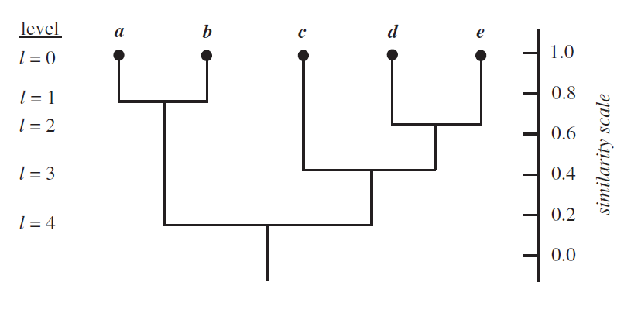
Hierarchical Clustering (1)
Groups data objects into a tree of clusters
Agglomerative
bottom-up merging
Decisive
top-down splitting
Dendrogram
Ravi Starzl, PhD - Data Mining Fall 2023
Notes:
Hierarchical clustering operates as a paramount technique in data analysis, enabling the grouping of analogous objects into clusters. The methodology, rooted in similarity measurement, seeks to create a dendrogram, a tree-like visual representation that elucidates the proximities or disparities between clusters. The technique is commonly divided into two primary methods: agglomerative clustering and divisive clustering.
Agglomerative clustering begins by treating each data point as a separate cluster, progressively merging the most similar clusters until only a single cluster remains. In contrast, divisive clustering starts with all data points in one cluster, iteratively dividing it into smaller clusters until each data point forms its own cluster. The decision to merge or split clusters is guided by various linkage methods, specifically single-linkage, complete linkage, and average linkage, each utilizing different strategies to determine the 'distance' between clusters.
Single-linkage considers the smallest possible distance between clusters, focusing on the closest points in each cluster for merging or splitting. Complete-linkage, on the other hand, employs the largest possible distance, emphasizing the furthest points within the clusters. Average linkage uses the average distance between all points in the clusters to guide its process.
The resultant dendrogram from hierarchical clustering serves not just as a visual guide but also as a tool that reveals the sequential merging or splitting of clusters, showcasing their relative similarities or differences. The entirety of the hierarchical clustering process hinges critically on the measure of similarity or distance and the choice of linkage method. The selection of these parameters should be done meticulously, accounting for the specific goals of the analysis and the characteristics of the dataset, as they directly influence the outcome of the clustering.
In practical applications, hierarchical clustering finds utility in a multitude of domains. For instance, in business, customer behavior data can be analyzed to uncover purchasing patterns and enhance targeting strategies. In biology, it can facilitate the categorization of organisms, while in archival science, it can help group similar documents for streamlined retrieval. Moreover, in healthcare, it can analyze patient data to identify critical trends or anomalies that are pivotal for patient care and management.

Slide 15
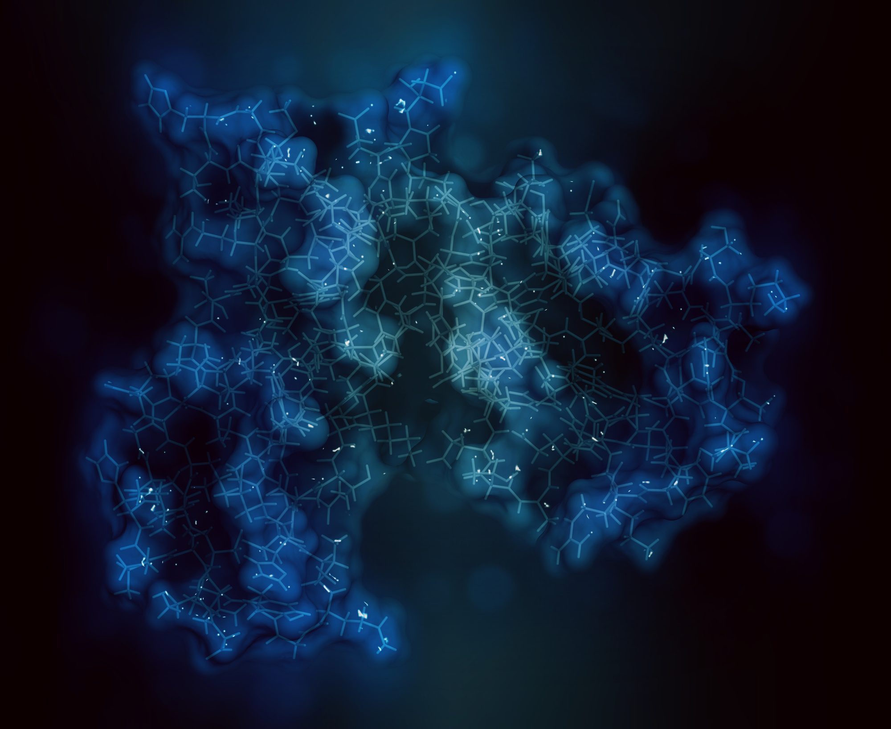
Hierarchical Clustering (2)
Uses distance matrix as clustering criteria
Cluster distance
centroid distance
point distance: min, max, average
No need to specify k (#clusters)
Termination condition
e.g., cluster distance exceeds a threshold
Cannot undo previous merge/split decisions
Ravi Starzl, PhD - Data Mining Fall 2023
Notes:
The distance matrix is a key concept in hierarchical clustering. This square matrix represents the distance between every pair of data points in the dataset. It is symmetrical because the distance from point A to point B is the same as the distance from point B to point A. The values in the distance matrix are used to determine which clusters or data points should be merged or separated to create the final hierarchy of clusters.
Distance calculation in hierarchical clustering can involve various methodologies, such as centroid distance and point distance. The centroid distance method forms clusters based on the geometric center of data points, measuring the distance between two clusters as the Euclidean distance between their centroids. Point distance, on the other hand, can involve minimum distance (or single linkage clustering), maximum distance (or complete linkage clustering), and average distance (or average linkage clustering) approaches to measure the dissimilarity between clusters.
Hierarchical clustering allows for determining the optimal number of clusters after the algorithm has been run, as opposed to K-means clustering, which requires the number of clusters to be predetermined. A dendrogram, which visually represents the cluster hierarchy, can be analyzed to determine cluster sizes. Additionally, a termination condition, which stops the algorithm when the distance between the newly formed cluster and the remaining clusters exceeds a predetermined threshold, must be established based on the specific dataset being used.
A limitation of hierarchical clustering is its inability to reverse previous merge or split decisions. Once two clusters have been combined, they cannot be separated in subsequent steps of the algorithm. Despite this limitation, hierarchical clustering is a valuable tool in various domains, including bioinformatics, pattern recognition, and computer vision, due to its unique approach to distance computation and its agglomerative or divisive nature.

Slide 16

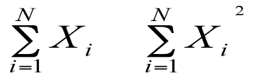
BIRCH
Clustering large amount of numerical data
Multi-phase clustering
Phase 1: microclustering
hierarchical clustering
Phase 2: macroclustering
e.g., iterative partitioning
Clustering feature
CF = <n, LS, SS>
Ravi Starzl, PhD - Data Mining Fall 2023
Notes:
BIRCH (Balanced Iterative Reducing and Clustering) using Hierarchies, is an algorithm designed to manage large datasets in a manner that is both efficient and robust, particularly focusing on numerical data. This algorithm operates through a distinct two-phase structure, which consists of microclustering and macroclustering phases.
The microclustering phase entails a preprocessing step where the raw numerical data is processed and compact microclusters are formed. These microclusters hold essential properties from the original dataset while simultaneously reducing computational and storage requirements. The reduction process is a form of compression where vital data properties are retained, not a loss of data.
A Clustering Feature (CF) Tree, an internal data structure, is utilized by BIRCH during this phase. Each node within this tree holds a summary of the dataset, while the overall tree maintains a balanced state. The CF Tree can store extensive information and lighten the computational load, preparing the data for the macroclustering phase.
Each CF is a triplet that includes 'n,' LS (Linear Sum), and SS (Square Sum), providing a thorough summary of the dataset. The variable 'n' indicates the number of data points in the cluster, LS is the vector sum of these data points, and SS is the sum of the square norm of these data points. This triplet encapsulates the essence of each cluster, offering a comprehensive snapshot of the data.
Following the creation of these CF triplets, the macroclustering phase begins, during which a hierarchical clustering method is applied to analyze the data in a multi-layered manner, yielding a dendrogram—a tree of clusters. Each node, except for leaf nodes, represents a cluster, and as one moves up the tree, clusters merge to provide broader representations of the initial dataset.
During the macroclustering phase, CFs take the place of original data and are then partitioned iteratively. This provides a high-level view of the transformation at the ground level, offering a detailed understanding of the data at both micro and macro levels. BIRCH effectively condenses large datasets, making them more manageable and amenable to effective analysis.
This algorithm finds practical applications in areas involving substantial amounts of numerical data, such as retail analytics, web data analysis, and scientific calculations. BIRCH serves to reduce complexity and enhance the efficiency of data analysis in contexts like handling customer data for a large retail entity or dealing with intricate web analytics.

Slide 17
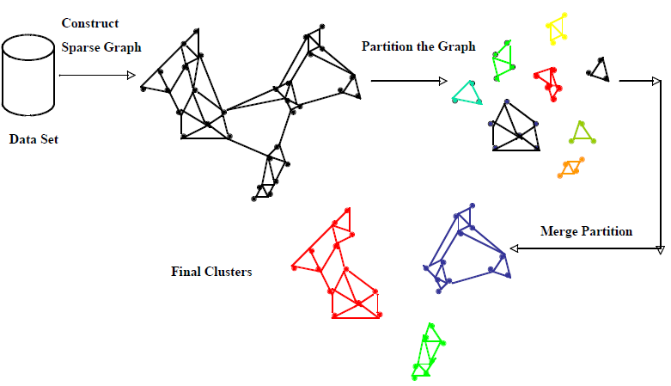
CHAMELEON (1)
Overall framework
k-nearest-neighbor graph
Graph partition: edge cut EC(Ci, Cj)
Relative interconnectivity (#edge cuts)
Relative closeness (avg weight of edge cuts)
Ravi Starzl, PhD - Data Mining Fall 2023
Notes:
The CHAMELEON Algorithm operates as an adaptive clustering method, modifying its strategy based on the data it processes, much akin to a chameleon altering its color according to its environment. A foundational element of this algorithm is the k-nearest-neighbor graph (k-NN graph), which creates a network model using data points as nodes, and connects them through edges to their k nearest neighbors, with proximity determined by distance between nodes.
In the functioning of the CHAMELEON Algorithm, the k-NN graph is partitioned using a method of edge cutting, thereby forming separate clusters of data. The algorithm employs two metrics to evaluate the significance of each edge cut and resultant partition: relative interconnectivity and relative closeness. Relative interconnectivity evaluates the dependency of two clusters on each other, considering the number of edge cuts between them. More edge cuts indicate a denser connection between clusters, making them less likely to be separated. On the other hand, relative closeness calculates the average weight of the edge cuts between two clusters, implying that a stronger average edge weight indicates nodes of clusters are closely aligned, making them likely to belong to the same cluster.
To practically apply the CHAMELEON algorithm, the following steps are undertaken: forming a k-NN graph using data points, utilizing a graph partitioning algorithm to create micro-clusters from the graph, pairing these partitions based on connectivity strength to form potential superclusters, and iterating through potential superclusters, merging those that adhere to established closeness and interconnectivity standards.
The resulting superclusters, formed through CHAMELEON's iterative assessment and combination process, demonstrate the algorithm's capability to navigate varying density distributions effectively. It maintains clusters that preserve characteristics of dense features and high interconnectivity, adeptly managing different data structures and successfully applying to real-world scenarios, particularly those involving substantial amounts of numerical data. The insightful use of relative interconnectivity and closeness allows CHAMELEON to adjust its approach in response to the diverse density landscapes it encounters, affirming its utility as a powerful tool in data analysis and machine learning.

Slide 18
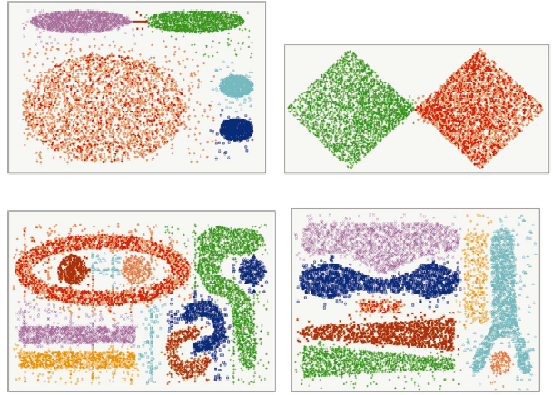
CHAMELEON (2)
Clustering complex objects
Ravi Starzl, PhD - Data Mining Fall 2023
Notes:
The CHAMELEON hierarchical clustering algorithm functions through a two-phase operational strategy, which involves partitioning and merging, to manage complex objects and efficiently cluster them. During the partitioning phase, each data point becomes a node and the algorithm creates graph edges to represent similarities between these nodes. Each edge is quantitatively weighted based on the similarity degree between the connected nodes. The algorithm employs a graph partitioning algorithm to divide the large structure into smaller sub-graphs or subclusters, allowing detailed shapes and densities to emerge, reflecting the inherent structure and relationships within the data.
CHAMELEON adapts its partitioning phase through an adaptive feature that adjusts the similarity measure according to a threshold, which is based on the estimated similarity of the k-nearest neighbors within each object. The selection of the 'K' value is crucial as it maintains a balance between handling noise and outliers and managing computational complexity. A high 'K' value assists in managing noise and outliers but increases computational complexity.
The second phase, the merging phase, introduces two measures - 'Relative Interconnectivity' and 'Relative Closeness'. Relative Interconnectivity measures the average strength of edges connecting two subclusters, indicating the unity degree between them. Conversely, Relative Closeness measures the physical proximity of objects within two different clusters, reflecting the segregation degree between them. Both measures are normalized based on the intra-connectivity and intra-closeness within the associated subclusters.
CHAMELEON utilizes these parameters to make informed decisions about merging subclusters, where subclusters with high relative interconnectivity and closeness are likely to be merged, forming a larger, cohesive cluster. This phase works on the principles of the Balanced Iterative Reducing and Clustering Using Hierarchies (BIRCH) model, clustering iteratively and adjusting the clusters according to inherent dependencies in the data.

Slide 19
1
Basic Concepts
2
Partitioning Methods
Cluster Analysis
3
Hierarchical Methods
4
Density-based Methods
5
Grid-based Methods
6
Evaluation of Clustering
Ravi Starzl, PhD - Data Mining Fall 2023

Slide 20
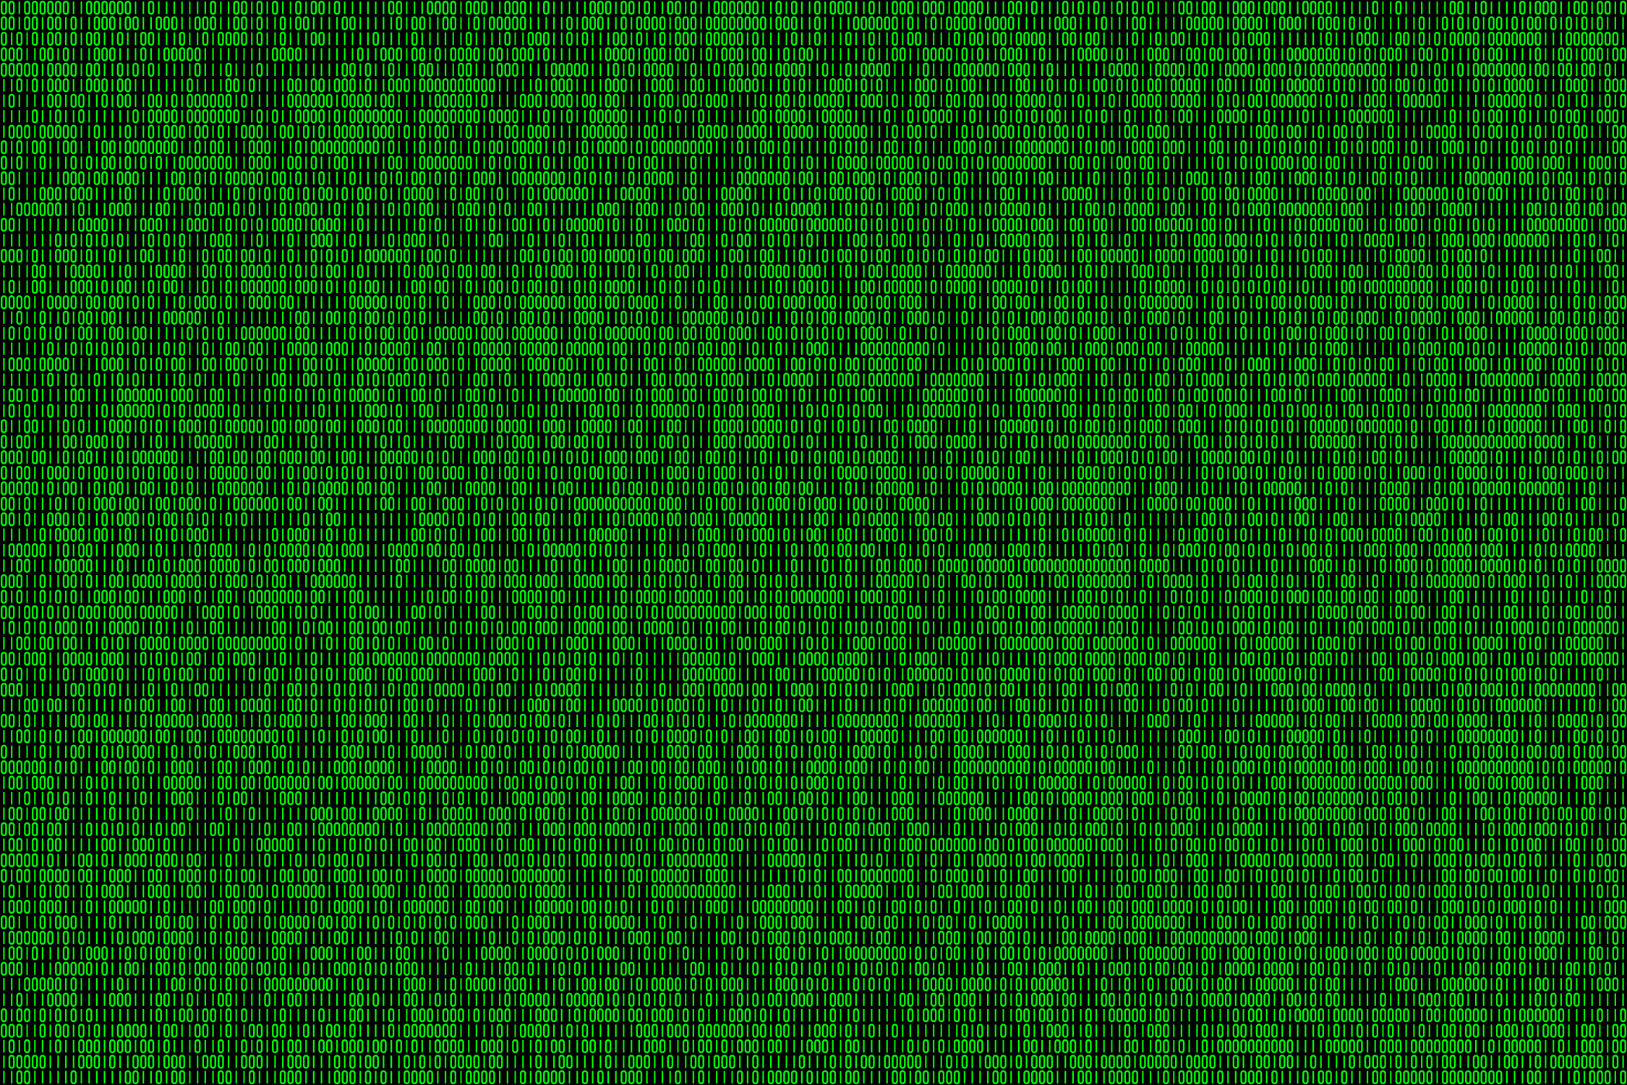
Density-Based Clustering
Clustering based on density (local cluster
criterion), e.g., density connected points
Typical methods
DBSCAN, DENCLUE
Major features
clusters of arbitrary shape, handles noise, single scan, density parameter for termination
Ravi Starzl, PhD - Data Mining Fall 2023
Notes:
Density-based clustering represents a category of clustering methods in data mining and data analysis that is fundamentally based on the principle that a cluster is a dense region of data points separated by regions of lower point density. In simple terms, a cluster is formed where there are many closely located data points, and it is separated from other clusters where the data points are scarce.
DBSCAN (Density-Based Spatial Clustering of Applications with Noise) is a particular method within density-based clustering. The method operates by defining a cluster as a maximal set of density-connected points. It explores the data space by growing clusters, and during this exploration, it makes decisions about whether a data point belongs to an existing cluster or should be labeled as noise. However, DBSCAN assumes that clusters are dense regions of similar density, which may not always be the case, and as such, this is a limitation of the method.
DENCLUE (Density-Based Clustering) is another method that relies on the distribution of representative points in the data space to find dense regions. It employs a hill-climbing algorithm that adjusts clusters based on the shifting of dense regions in the data space. While DENCLUE can accurately determine cluster shapes and identify noise, it often comes with high computational complexity, which can be a limiting factor for its application on larger datasets.
Comparing density-based clustering methods like DBSCAN and DENCLUE to other clustering methods, such as K-means or hierarchical clustering, reveals several distinctive features. For instance, density-based methods can manage clusters of various shapes and sizes and are adept at handling noise in the data. This is in contrast to methods like K-means, which often assumes that clusters are convex shaped.
Advantages of employing density-based clustering include its ability to manage datasets with noise and its capacity to identify clusters of arbitrary shapes. Moreover, density-based clustering methods often require less computational effort compared to other clustering methods, which can be particularly beneficial when dealing with large datasets.

Slide 21
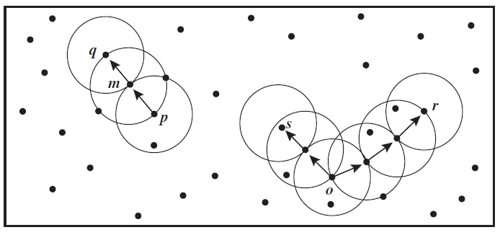
DBSCAN (1)
ε-neighborhood of p: within radius ε of p
Core object p: at least MinPts points in the ε-neighborhood of p
Directly density reachable
Density reachable
Density connected
Ravi Starzl, PhD - Data Mining Fall 2023
Notes:
In DBSCAN, the neighborhood of a point, referred to as ε-neighborhood, consists of all points within a specified distance from that point. The distance threshold, known as ε, plays a crucial role in clustering, and different ε values produce varied results.
Two key concepts in DBSCAN are 'core object' and 'MinPts'. A core object is one that has a minimum number of 'MinPts' within its ε-neighborhood, indicating a cluster's presence. 'MinPts' is a set constant denoting the least number of points needed for a region to be considered dense.
Two relationships between dataset points are 'Direct density-reachable' and 'Density-reachable'. A point is directly density-reachable from another if it resides within the ε-neighborhood of that point, and the latter is a core object. Density-reachable, conversely, implies that a point can be reached from another via a sequence of points, each directly reachable from the next.
'Density-connected' describes a situation where two points are both density-reachable from a common point. Understanding this term's implications requires practical examples, particularly ones highlighting how parameter choices influence outcomes.
When executing DBSCAN, it starts by randomly picking a point. If sufficient points lie within the ε distance from this point, a cluster is initiated, and all neighboring points are incorporated into it. This step is recurrently performed for each added point. Points with fewer neighbors than 'MinPts' are labeled as noise. The algorithm then moves to another unexamined point, continuing until all points are evaluated.

Slide 22
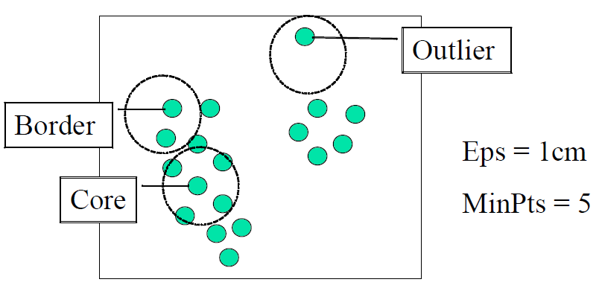
DBSCAN (2)
Cluster: a maximal set of density connected points
Check ε-neighborhood of each point p
Core object? Border object?
Ravi Starzl, PhD - Data Mining Fall 2023
Notes:
DBSCAN, which stands for Density-Based Spatial Clustering of Applications with Noise, is a clustering method that focuses on the density of data points and their spatial distribution. Unlike other clustering methods, DBSCAN identifies clusters based on the density of data points, making it especially adept at discerning clusters of varied shapes and sizes.
A fundamental concept in DBSCAN is the notion of a cluster. In this context, a cluster is defined as the largest group of points that are density-connected. This means that within a cluster, every point has a sufficiently dense neighborhood of other points.
To determine the clusters, the algorithm checks the ε-neighborhood for each data point, denoted as point (p). The ε-neighborhood refers to all the points that lie within a radius ε from point (p). This radius acts as a measure of proximity, and its value can greatly influence the outcome of the clustering.
In the process of clustering, DBSCAN classifies data points into different categories based on their density. One of the key categories is the core object. A core object is a point that has a minimum number of other data points within its ε-neighborhood. This signifies a local density and is indicative of the presence of a cluster.
On the other hand, a border object is a point that lies within the ε-neighborhood of a core object but doesn't have a sufficient number of neighboring points to be classified as a core object itself. In essence, while it is close to a dense region (core object), it doesn't contribute significantly to the density.
Overall, the DBSCAN algorithm offers a unique approach to clustering by relying on the spatial density of data points, making it effective for datasets where clusters are irregularly shaped or varied in size.

Slide 23
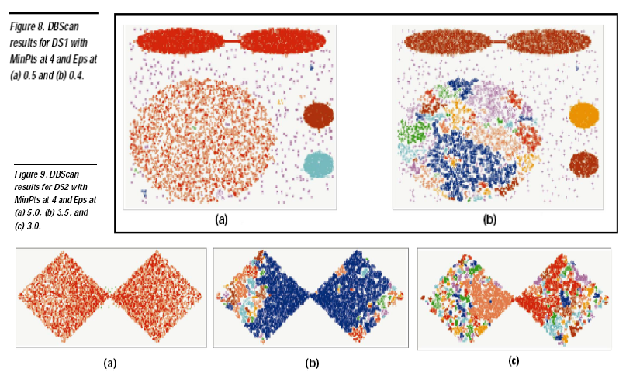
DBSCAN (3)
Sensitive to parameters: ε and MinPts
Ravi Starzl, PhD - Data Mining Fall 2023
Notes:
In the DBSCAN clustering algorithm, two primary parameters that significantly influence the results are ε (epsilon) and MinPts.
The parameter ε defines the radius for the neighborhood around a data point. Specifically, the ε-neighborhood of a point includes all points that lie within this radius from the given point. By adjusting the value of ε, one can change the size of this neighborhood, which in turn can lead to different clustering outcomes. A smaller ε might result in more clusters and more noise, whereas a larger ε might merge clusters that are distinct at a smaller scale.
MinPts, on the other hand, determines the minimum number of data points required within the ε-neighborhood of a point for that point to be considered a core object. This parameter essentially sets the density threshold for clusters. A higher MinPts value implies a stricter density requirement, potentially leading to fewer core objects and more noise or border points.
Both ε and MinPts are critical because they jointly define the notion of density in DBSCAN. However, the algorithm can be quite sensitive to the values chosen for these parameters. Inappropriate choices might lead to over-segmentation or under-segmentation of data. Therefore, understanding the data distribution and experimenting with different parameter values is crucial to obtain meaningful clustering results using DBSCAN.

Slide 24

DENCLUE (2)
Influence function: impact of a data point within its neighborhood
Overall density: sum of the influence function of all data points
Density attractors: local maximal of overall density function
Clusters can be determined mathematically by identifying density attractors
Ravi Starzl, PhD - Data Mining Fall 2023
Notes:
The Influence Function is a foundational concept within the DENCLUE algorithm. It is essentially a measure of a data point's impact within its local vicinity, tapering off exponentially as distance from the data point increases. In simpler terms, each data point is surrounded by a sphere of influence, which diminishes as one moves farther away from the point.
The notion of Overall Density takes the influence function a step further by providing a cumulative view of the dataset. It is computed as the total sum of the influence functions of all data points at a specific location within the data space. The metric, therefore, provides a comprehensive view of data distribution, pointing out areas of high and low data density.
Density Attractors, another pivotal concept in DENCLUE, can be envisioned as the gravitational centers within the data space. They are identified as local maxima of the overall density function, essentially acting as the centroids of their respective clusters. Density attractors have the highest density within a particular region and pull in data points closer to them, thereby forming the foundation upon which clusters are built.
Practical applications of DENCLUE underscore its efficiency in delineating clusters within large datasets. By leveraging its mathematical foundation, DENCLUE not only simplifies the otherwise complex task of data clustering but also excels in identifying clusters of varied shapes and sizes.
The fundamental components of DENCLUE – the influence function, overall density, and density attractors – work in tandem to formulate the clustering process. Each data point contributes to shaping the overall density, which, in turn, reveals the location of density attractors. These density attractors guide the formation and definition of clusters, ensuring a logical and harmonious clustering process.

Slide 25
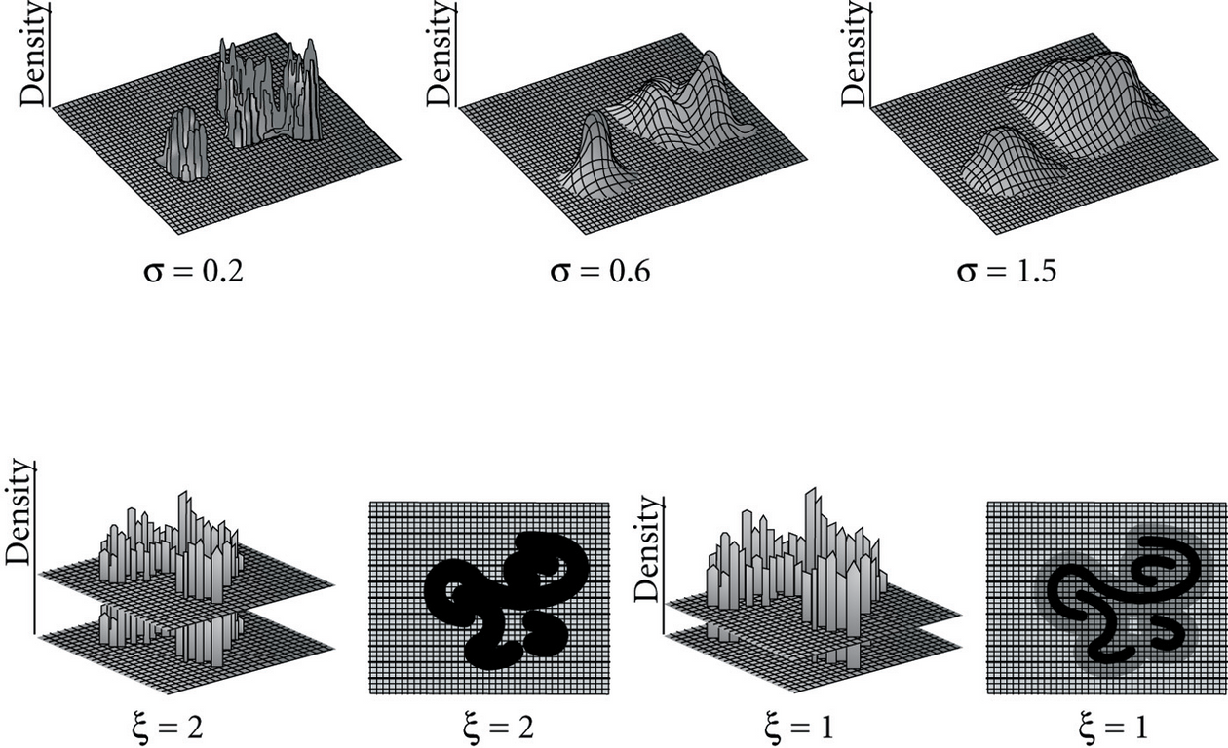
DENCLUE (3)
Center-defined or arbitrary-shaped clusters
Ravi Starzl, PhD - Data Mining Fall 2023
Notes:
Center-defined clusters, one of the types identified by DENCLUE, are clusters that are characterized by a clear, central point. Visualizing these on a two-dimensional plot, each data point in the cluster is proximal to a defined central point, often resulting in a uniform, typically circular, shape. This type of cluster is often managed using conventional clustering methods like k-means, which employs a distance metric, commonly the Euclidean distance, from a determined mean point to ascertain whether a data point belongs to a cluster.
Conversely, arbitrary-shaped clusters do not conform to a specific shape. These clusters can be elongated, circular, or crescent-shaped, presenting more complex formations than center-defined clusters. Traditional clustering techniques, such as k-means or hierarchical clustering, often struggle to manage these non-standard formations due to their inability to accommodate non-spherical structures and potentially lacking a clear center. DENCLUE, however, adeptly manages these complex, non-standard formations.
The kernel density estimation approach, which is integral to the density distribution model employed by DENCLUE, calculates the density of data points in the dataset space, with regions of higher data point densities becoming density attractors or clusters. Imagine a hilly landscape where hilltops represent high-density regions, equivalent to cluster central points. Data points are placed within a cluster based on the "hill" they "climb", following the density function gradient. If data points climb the same hill, they are considered part of the same cluster.
The kernel used in density estimation within DENCLUE is the Gaussian kernel, a mathematical function that estimates each data point's density within the space. The density associated with a point in the dataset space is accumulated from the influences of all surrounding data points, using an influence function that operates inversely - the further away a data point is, the less it contributes to density estimation.
In DENCLUE, every data point generates a density around itself, forming a "hill" in regions of the dataset space where data points are densely packed. The higher the density of points in close proximity, the taller the hill. Each data point climbs this hill, following the density gradient, until it reaches the peak, representing the densest part of that hill.
The kernel density estimation model employed by DENCLUE overcomes the distance-based limitations of other clustering algorithms by analyzing the overall distribution of data, rather than focusing on distances between individual points. This approach allows DENCLUE to identify a wide variety of complex, arbitrary-shaped clusters. DENCLUE also separates significant hills from insignificant ones by setting a density threshold. If a hill's peak density exceeds this threshold, it is deemed significant; otherwise, it is treated as noise.
Despite its capabilities, DENCLUE can be computationally intensive, particularly with large datasets, potentially limiting its application. Nevertheless, various optimization techniques can mitigate this, such as selecting a suitable influence function, determining an optimal sample size, and utilizing a grid structure to reduce computational load.

Slide 26
Basic concepts
Major Clustering Methods
Partitioning methods
k-Means
k-Medoids
Hierarchical methods
Hierarchical Clustering
BIRCH
CHAMELEON
Density-based methods
DBSCAN
DENCLUE
Summary
Ravi Starzl, PhD - Data Mining Fall 2023

Slide 27
Thank you
A special thank you to Qin Lv for her slides, on which this lecture is based
Ravi Starzl, PhD - Data Mining Fall 2023

